Slide 1
Private Higher Education
Sydney
160 Sussex St.
Sydney NSW 2000
Phone:+61 2 8265 3200
Email: info@eca.edu.au
Parramatta
1-3 Fitzwilliam St. Parramatta, NSW 2150
Phone:+61 2 8265 3200 Email: info@eca.edu.au
Melbourne
Level 7, 399 Lonsdale St.
Melbourne VIC 3000
Phone: +61 3 9603 5333
Email: info@eca.edu.au
Brisbane
Ground Floor, 269 Wickham St, Fortitude Valley 4006 Brisbane City QLD
T: 07 3210 7402
Email: info@eca.edu.au
United Kingdom
166-220 Holloway Rd
London N7 8DB
United Kingdom
Phone: +44 (0)20 3764 2500 Email: info@eca.edu.au
India
ECA Corporate House,
100 Ft Corporate Road, Ahmedabad – Gujarat – India
Phone: +91 7600 300 006
Email: info@eca.edu.au

Slide 2
ECA Group

Slide 3
ECA Course Offerings
APIC
Master of Project Management and Business (MPMB)
Master of Business Administration (MBA)
APIC
Master of Information Technology (MIT)
APIC
MPMB
MBA
HELI
Master of eLearning
Master of Research
Bachelor Degree in
Engineering
Bachelor Degree in
Computer Science / IT
Bachelor Degree in
Business/Commerce or Others
Bachelor Degree in
Education / Teaching
or Others
HELI
Master of Research
HELI
Master of Research
CHS
Master of Health Management
APIC
Business courses
Diploma of Business (DBus)
Bachelor of Business (Bbus)
IT courses
Diploma of Business Information System (DBIS)
Bachelor of Business Information System (BBIS)
Bachelor of Information Technology (BIT)
Health Sciences
Bachelor Degree or Experience in Several Areas
Year 12
Click
Please note these are our recommendations, students are free to choose any course where they meet entry requirements

Slide 4
Campuses
BRISBANE
SYDNEY
MELBOURNE

Slide 5
At a Glance
Asia Pacific International College (APIC) is a dynamic Australian Institute of Higher Education offering undergraduate and postgraduate degree courses at two campuses in Australia.
APIC’s courses are accredited by the Tertiary Education Quality and Standards Agency (TEQSA), Australia’s independent national quality assurance and regulatory agency for higher education

Slide 6
Courses
Business
Information Technology
Project Management
UNDERGRADUATE
Diploma of Business
Bachelor of Business
POSTGRADUATE
Graduate Certificate in Business Management
Graduate Diploma of Business Management
Master of Business Administration
UNDERGRADUATE
Diploma of Business Information System
Bachelor of Business Information System
POSTGRADUATE
Graduate Certificate in Information Technology
Master of Information Technology
POSTGRADUATE
Graduate Certificate in Project Management
Graduate Diploma of Project Management
Master of Project Management and Business

Slide 7
2023 Intake Dates
T1: 13 February 2023
T2: 12 June 2023
T3: 2 October 2023
Entry Requirement
Postgraduate
Undergraduate
Academic
AU Bachelor, or equivalent
English language
IELTS Academic 6.5 – no band below 6.0, or equivalent
Academic
Diploma degree
AU Year 12 (ATAR 55), or equivalent
Bachelor degree
AU Year 12 (ATAR 65), or equivalent
English language
Diploma degree
IELTS Academic 5.5 - no band below 5.0, or equivalent
Bachelor degree
IELTS Academic 6.0 - no band below 5.5, or equivalent

Slide 8
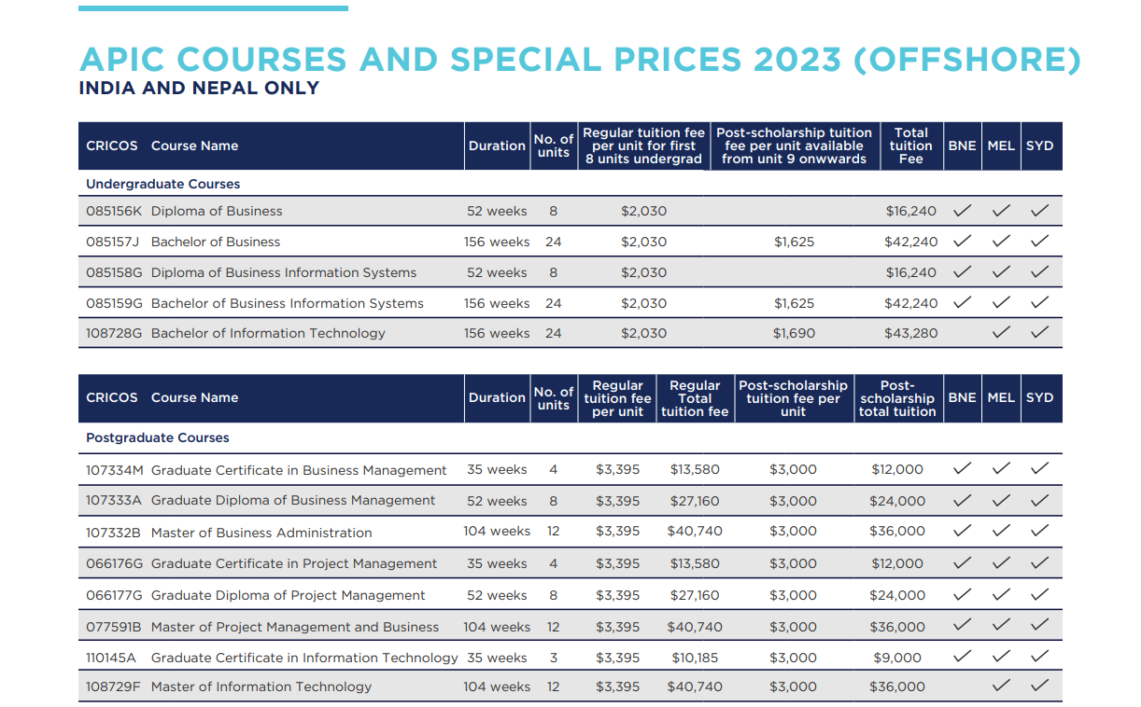

Slide 9
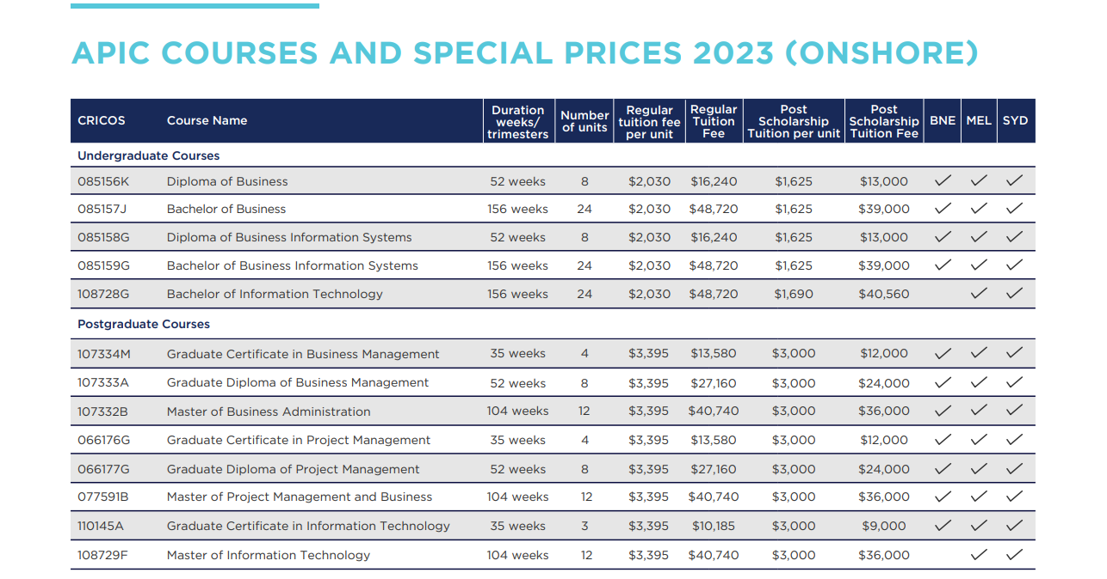
2023 Tuition Fee

Slide 10
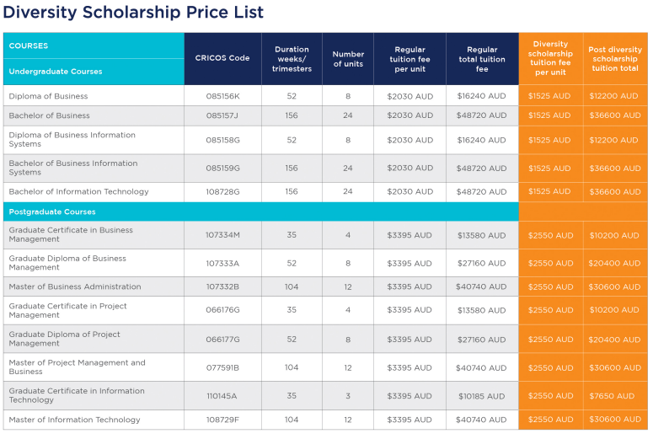
2023 Diversity Scholarship

Slide 11
At a Glance
The ECA College of Health Sciences is a private higher education provider delivering high quality education programs that prepare students for enhanced professional practice and leadership in their field while engendering lifelong learning and strong ethics.

Slide 12
Courses
Health Management
Graduate Certificate in Health Management
(CRICOS 106939A)
Graduate Diploma of Health Management
(CRICOS 106940H)
Master of Health Management
(CRICOS 106941G)
26 weeks
52 weeks
104 weeks
3 units
6 units
12 units
AUD 10,050 (2023)
AUD 20,100 (2023)
AUD 40,200 (2023)

Slide 13
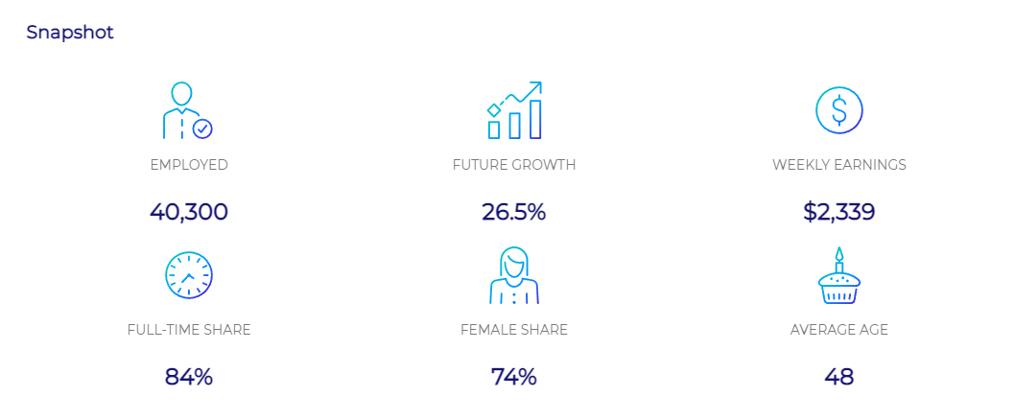
Why Health Management
(according to the latest statistics from the Labour Market Insight (https://labourmarketinsights.gov.au/occupation-profile/health-and-welfare-services-managers?occupationCode=1342)

Slide 14
2023 Intake Dates
Entry Requirement
T1: 6 March 2023
Academic
Recognised Bachelor degree (AQF 7) or equivalent in health-related discipline
English language
Academic IELTS 6.5 no band below 6.0, or equivalent
T2: 10 July 2023
T3: 6 November 2023

Slide 15
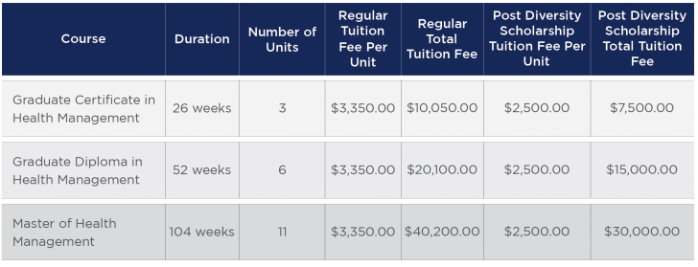
2023 Diversity Scholarship

Slide 16
At a Glance
Through its team of higher education experts and researchers, the Higher Education Leadership Institute (HELI) delivers leading-edge qualifications in higher education learning and teaching, with emphasis on the growing importance of the eLearning domain.
HELI aims to be catalyst for the continued professional development of learning and teaching professionals and higher education teachers globally.

Slide 17
Courses
HE Academic Practice
eLearning
Research
Graduate Certificate in HE Academic Practice
Graduate Certificate
Graduate Diploma
Master
Graduate Certificate in Research Methods
Master of Research
AUD 12,000 (2023)
AUD 12,000 (2023)
AUD 12,000 (2023)
AUD 24,000 (2023)
AUD 36,000 (2023)
AUD 36,000 (2023)

Slide 18
2023 Intake Dates
Entry Requirement
T1: 30 January 2023
Higher Degree by Research
Academic
Recognised Bachelor degree (AQF 7) or equivalent, GPA – credit average (>65%)
English language
Academic IELTS 6.5 no band below 6.0, or equivalent
Other HELI courses
(HE Academic Practice and eLearning)
Academic
Recognised Bachelor degree (AQF 7) or equivalent
English language
Academic IELTS 6.5 no band below 6.0, or equivalent
T2: 24 April 2023
T3: 17 July 2023
T4: 9 October 2023

Slide 19
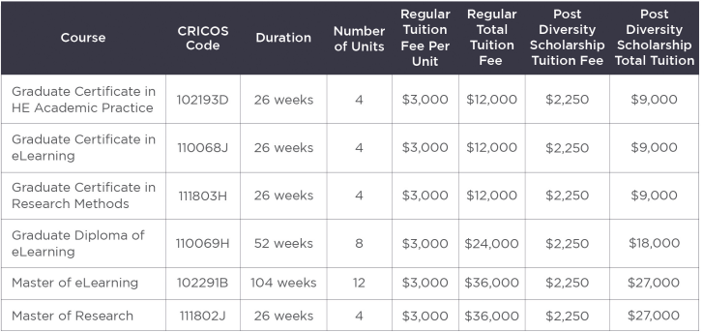
2023 Diversity Scholarship

Slide 20
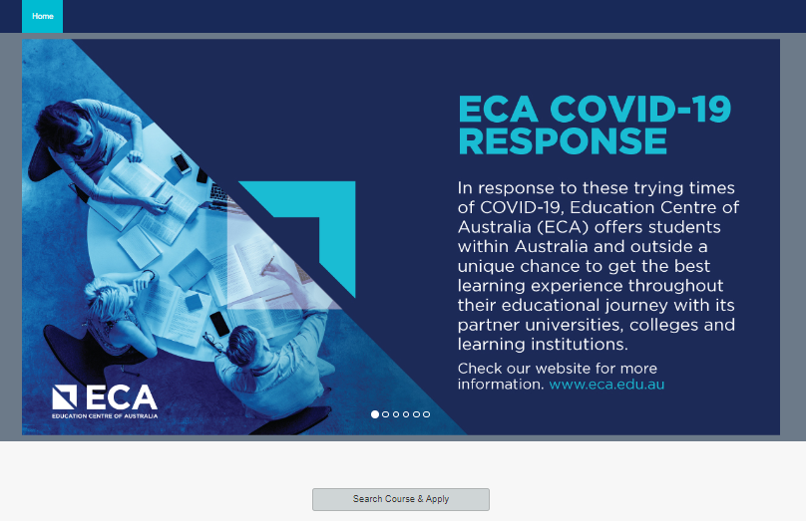
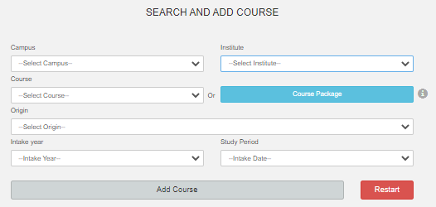
How to apply?
https://apply.eca.edu.au/Default_MIS
Click here

Slide 21
How to apply?
Stage1 : Complete the application form
You can Apply Online or using a registered education agent. Please ensure you complete all relevant sections, and the information is accurate.
Stage 2: Provide certified documents
Attach certified copies of any certificates, academic transcripts or results notices that show you meet the entry requirements of your selected course.
Stage 3: Submit your application
Submit your completed application through the platform or if you need support email to Student Admissions

Slide 22
ECA AGENT PORTAL- How to apply?
Discover how to apply step by step

Slide 23
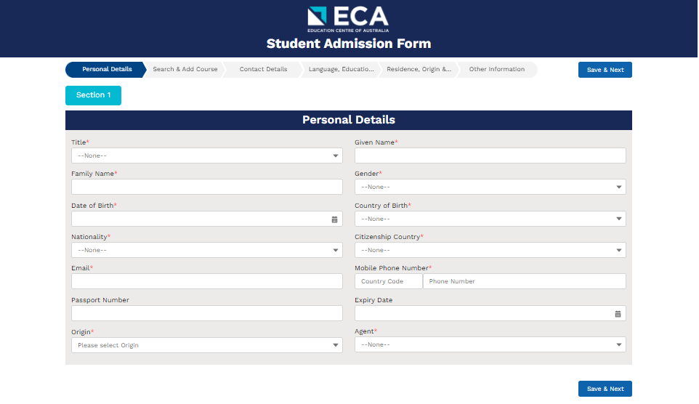
How to apply?
https://educationcentreofaustralia.force.com/s/student-admission

Slide 24
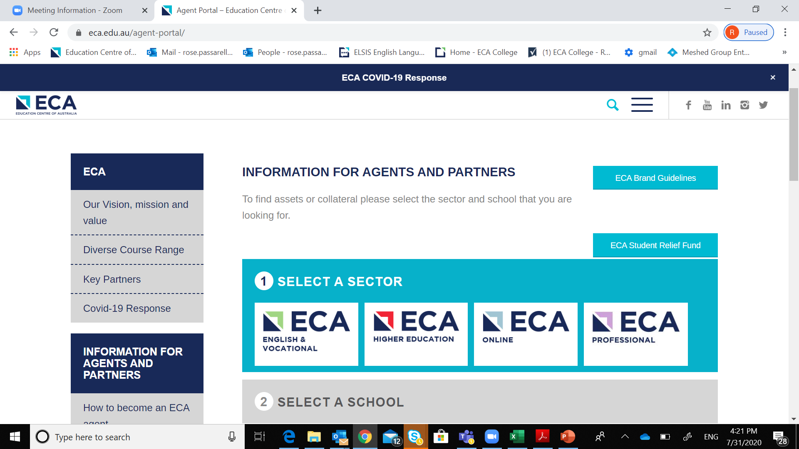
ECA Agent Portal
https://www.eca.edu.au/agent-portal/
Please choose ‘ECA Higher Education’ for marketing collateral and documents for APIC, CHS and HELI.

Slide 25
Q & A

Slide 26
Sydney
160 Sussex St.
Sydney NSW 2000
Phone:+61 2 8265 3200
Email: info@eca.edu.au
Parramatta
1-3 Fitzwilliam St. Parramatta, NSW 2150
Phone:+61 2 8265 3200 Email: info@eca.edu.au
Melbourne
Level 7, 399 Lonsdale St.
Melbourne VIC 3000
Phone: +61 3 9603 5333
Email: info@eca.edu.au
Brisbane
Level 1, 126 Margaret St.
Brisbane QLD 4000
Phone: +61 7 3210 7474
Email: info@eca.edu.au
United Kingdom
166-220 Holloway Rd
London N7 8DB
United Kingdom
Phone: +44 (0)20 3764 2500 Email: info@eca.edu.au
India
ECA Corporate House,
100 Ft Corporate Road, Ahmedabad – Gujarat – India
Phone: +91 7600 300 006
Email: info@eca.edu.au

